Slide 1

QuantumX24 HACKATHON
-team TechTriad

Slide 2
Build a Route Optimisation tool that uses AI to generate optimized routes for better traffic control and fuel efficiency in real time.
Problem Statement 7

Slide 3
In the fast-developing logistics and supply chain management fields, one of the critical problems in the decision-making system is that how to arrange a proper supply chain for a lot of destinations and suppliers and produce a detailed supply schedule under a set of constraints. Solutions to the multisource vehicle routing problem (MDVRP) help in solving this problem in case of transportation applications.

Slide 4
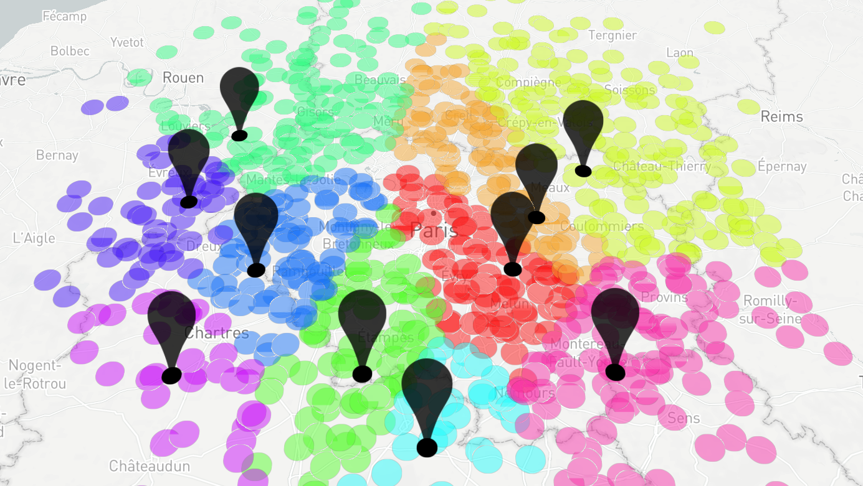
For the locations of sources (pins) and destinations (circles) the MDVRP requires the assignment of destination to sources and the vehicle routing for visiting them. Each vehicle originates from one source, serves the destinations assigned to that source, and returns to the same source.

Slide 5
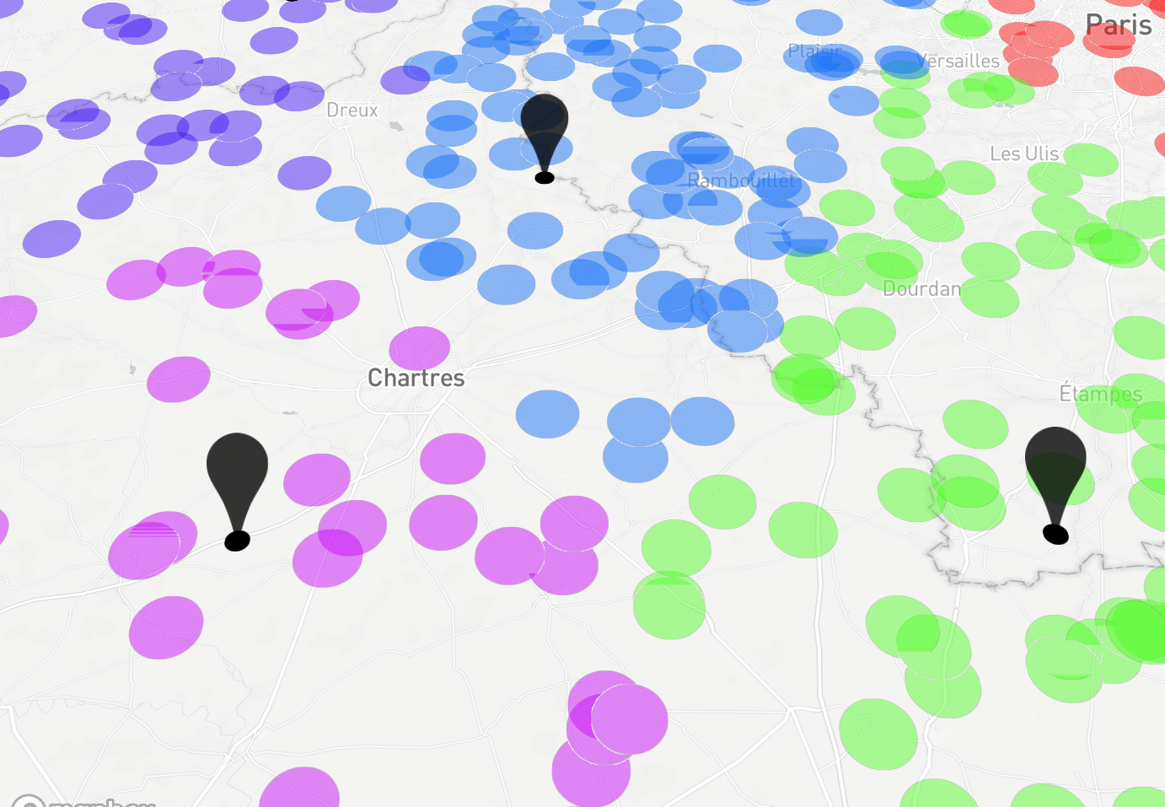
The objective of the MDVRP is to serve all destinations while minimizing the total travel distance (hence cost) under the constraint that the total demands of served destinations cannot exceed the capacity of the vehicle for each route.

Slide 6
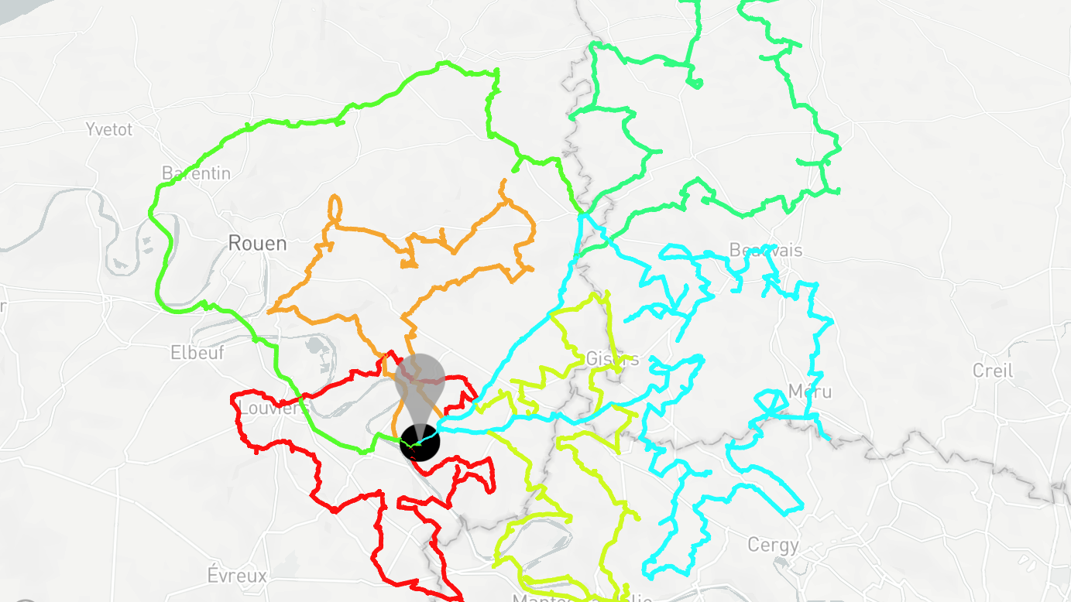
This project uses a heuristic algorithm to solve this problem. The proposed algorithm consists of four phases:
Phase 1: Find the destination nodes which will be catered by each source node using a modified k-means clustering algorithm.
Phase 2: Do preliminary analysis on the points for determining the type and number of the vehicles for given constraints.
Phase 3: Assign the vehicle to the subsets of the destination points using K-means while minimizing the fuel cost.
Phase 4: Optimize the routing for the allotted locations using Travelling Salesman optimization) for each vehicle.

Slide 7
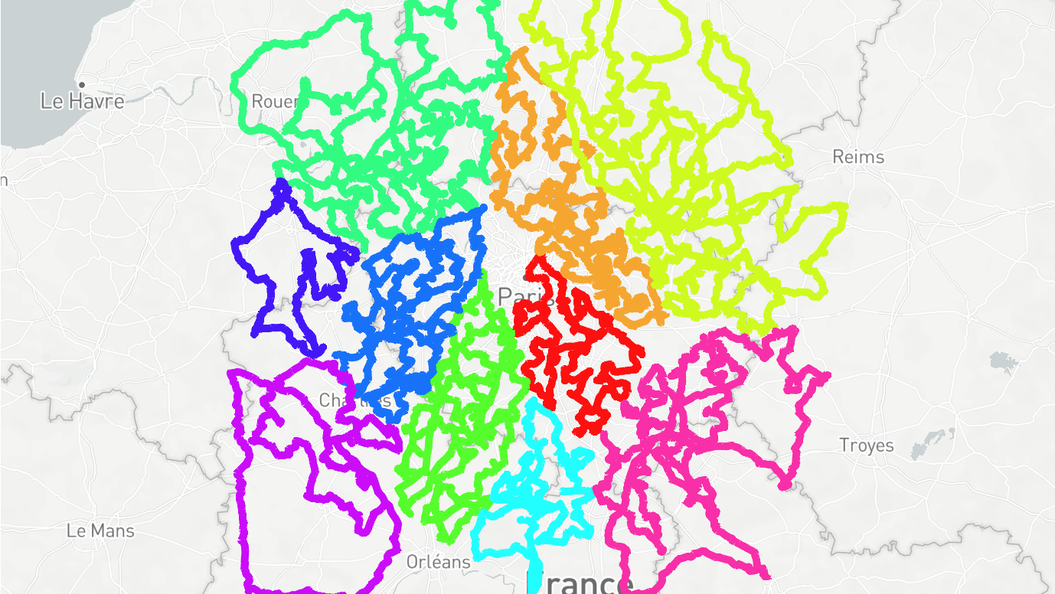
The data used is synthetic and a considerable effort was put to achieve faithful results.

Slide 8
We experimented with multiple existing approaches to VRP, including genetic algorithms and recursive-DBSCAN. However, we found the modified K-means strategy to be most performant when scaled to large data.

Slide 9
The modified K-means clustering algorithm is biased towards frugality because the problem statement had minimal time constraints.

Slide 10

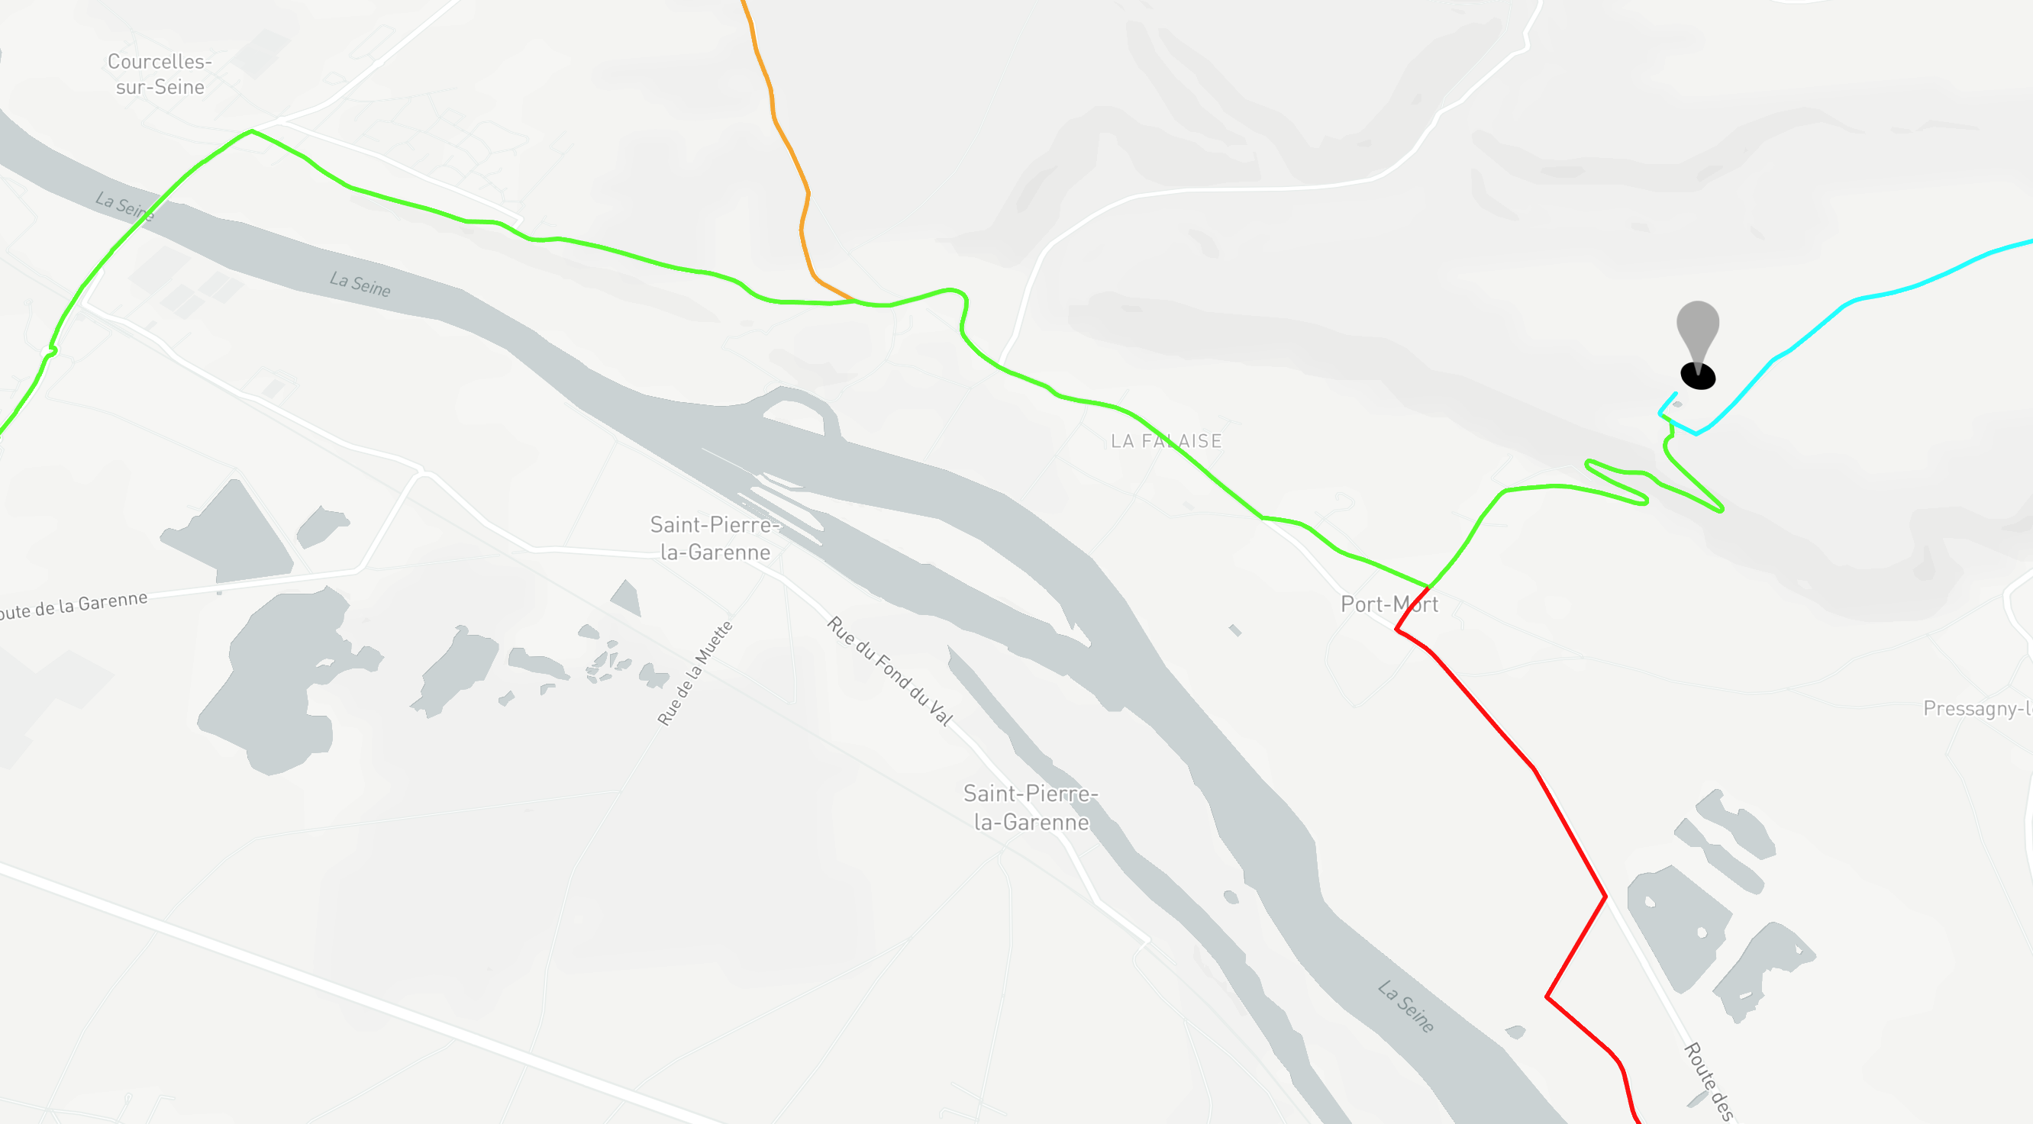
However, we found our strategy to be most performant when scaled to large datapoints. One of the primary reasons is the relative simplicity and the speed of execution, which allows greater flexibility during the implementation.

Slide 11
Primary tools
Azure Maps (distance API and routing)
Azure Machine Learning (training modified K-NN)
Azure Notebooks (prototyping and data analysis)
MapBox, Streamlit and Deck.gl for visualization
Heroku (Web-based deployment)

Slide 12
THANK YOU
TECHTRIAD
Yashas D

